Slide 1
Proposal Planning & Submission Process

Slide 2
Proposal Submission & Review https://www.nursing.arizona.edu/resources/research
Planning to submit an extramural
grant proposal?^{ǂ}
Complete Intent to Submit Form (ITS) and submit to CON-ORS@email.arizona.edu and preaward@email.arizona.edu
(6-8 weeks prior to submission deadline*)
*Exceptions for funding opportunities with tight turnaround from original posting)
Office of Research & Scholarship (ORS)
UAHS Administration
(Preaward)
Consult with ORS staff on resources, proposal planning, assistance needed with application
(6-8 weeks prior to submission deadline*)
Sends proposal checklist and timeline to PI.
(4-6 weeks prior to submission deadline)
Works with PI to create budget, coordinates subawards, if applicable.
(4 weeks prior to submission deadline)
Proposal review panel is selected and contacted.
(6 weeks prior to submission deadline)
Proposal is submitted to ORS and is sent to the proposal review panel.
(4 weeks prior to submission deadline)
Coordinates collection and formatting of biosketches and letters of support, provides standard sections for PI editing (e.g., facilities and resources)
(2-4 weeks prior to submission deadline)
Review panel returns proposal submission with comments and revision suggestions.
(2 weeks turnaround time required)
Routes budget through UAccess Research
(1-2 weeks prior to submission deadline)
PI has approximately 1-2 weeks to implement any changes and send final documents to Preaward for final formatting before submission deadline.
Formats and prepares final application
(1 week prior to deadline)
ǂIntramural submissions can benefit from this process, too.
Submits to Sponsored Projects
(3 days prior to submission deadline)

Slide 3
Intent to Submit (ITS) Form
(6 – 8 Weeks Prior to Deadline)
ITS PURPOSE
ORS
Help with Grant Application
Arrange for Pre-Review
Advocate for CON Faculty
CON Approval (Division and College)
UAHS ADMINISTRATION (PREAWARD)
Plan for Submission
Generate Proposal Checklist

Slide 4
Proposal Planning
(6 – 8 Weeks Prior to Deadline)
ASSISTANCE AVAILABLE
ORS
Funding Opportunities
Study Design & Methods
Collaborators
Statistical Consulting
DEPARTMENT CHAIRS
Study Design & Methods
Collaborators
PREAWARD
Budget Preparation
Coordinate Subawards

Slide 5
Pre-Review
(4 – 6 Weeks Prior to Deadline)
PURPOSE OF PRE-REVIEW
More Competitive Application
Feedback from Experts
  Content Specialists
  Experienced Reviewers
Ensure adequate resources
Select and Contact Reviewers (6 weeks prior to deadline)
Send to Reviewers (4 weeks prior to deadline)
Return Reviews (2 weeks prior to deadline)
TIMELINE FOR PRE-REVIEW

Slide 6
Preaward
(1 – 6 Weeks Prior to Deadline)
PREAWARD PROCESS
Creates Budget
Coordinates Subawards
Coordinates & Formats
  Biosketches
  Letters of Support
  Standard Sections (e.g., Facilities & Resources)
Routes Budget through UAccess Research (UAR)
Formats and Prepares Final Application
PI Reviews Final Application
Submits Application to Office of Sponsored Projects

Slide 7
Sponsored Projects
(3 Days Prior to Deadline)
SUBMISSION PROCESS
Submits Final Application
Sends Confirmation
For Federal Grants, PI Logs In and Reviews Final Application
  If good, proposal is submitted
  If errors, recall, revise and resubmit

Slide 8
Proposal Review
PROCESS VARIES
Federal Applications
  Assigned to Study Section
  Reviewed 3-6 Months after Submission
  Results 3-30 Days after Review
  Feedback Provided
  Funding Based on Review and Institute Priorities (1-3 Months after Review)
  Let ORS Know of Result
Foundations
  Varies Dependent on Foundation
  Usually Quicker Turnaround
  Feedback Not Always Provided

Slide 9
Proposal Resubmission
ORS & PREAWARD
Send Results/Summary Statement
  Collaborators
  ORS
Decide Whether to:
  Revise and Resubmit
  Submit as New
  Try Something Else
Persistence Pays Off!

Slide 10
Questions
?
https://www.nursing.arizona.edu/ors

Slide 11
An Overview of Research Funding & UAHS Services
Sponsored Projects, Budgets, RFAs
Shannon Carver
Assistant Director
Elisha Johnson
Assistant Director
Christine Gaul
Associate Director
Sarah Clarke
Senior Research Administrator
University of Arizona Health Sciences
Research Administration

Slide 12
What is a Sponsored Project?
Agreement for funds from a federal, state, or private organization provided on a contractual or grant basis and used for a specific purpose.
Requires separate accounting procedures and reports or other deliverables
Involves programmatic decision making, effort, analysis or interpretation to carry out objectives
Negotiated between University and sponsor and requires signature of official UA signatory

Slide 13
Grants and Clinical Trials
GRANTS
CLINICAL TRIALS
An award of financial assistance for research, instruction, or other sponsored activity
Awarded on a competitive basis to recipients responding to a sponsor's program announcement
Specific period of performance
Cost reimbursement
A type of clinical research that follows a pre-defined plan or protocol involving controlled, clinical testing in humans
May be conducted under industry-developed or investigator-initiated trial protocol
Open until recruitment goals met
Fee-for-service (milestone)

Slide 14
NIH-Funded Clinical Trials
On January 25th, 2018, NIH released FORMS-E and put in place new policies regarding Clinical Trials reporting and Human Subjects studies. This was a major change to NIH funding and required a complete overhaul of active Program Announcements and RFAs.
Clinical Trials may only be proposed on PAs/RFAs/PARs that specifically allow them.
https://grants.nih.gov/policy/clinical-trials/new-human-subject-clinical-trial-info-form.htm

Slide 15
Applying for Funding
  Fit with area of interest
  Sponsor requirements
  Review the program announcement
  Submission format/process
  Internal requirements/approvals
  Deadlines

Slide 16
Proposal Development
A proposal (application) consists of:
  The narrative of proposed work
  Budget and budget justification
  Credentials/qualifications of the people involved
  Letters of support
  Forms/formats required by the funding party

Slide 17
Successful Applications
Are the result of:
  Planning – weeks & months, not hours & days
  Following instructions
  Demonstrating:
    PI/Team is qualified to perform the proposed aims
    PI is current in the field (literature, recent developments, etc.)
    The proposed aims are in line with the sponsor’s area of interest/public need
    The scale of the proposal is appropriate to the time/resources being requested

Slide 18
PreAward Services
  Review of eligibility & sponsor requirements
  Provision of Timeline & Checklist
  Budget and budget justification development
  Internal routing through UAccess Research
  Acquisition of Letters of Support
  Provision of templates for Facilities & Resources, and others
  Awareness of Sponsor-specific Forms
  Application completion via ASSIST, Proposal Central, FastLane, etc…
  Submission through SPCS and/or sponsor portal
  Post-submission materials (Just-in-Time, rebudget, etc.)

Slide 19
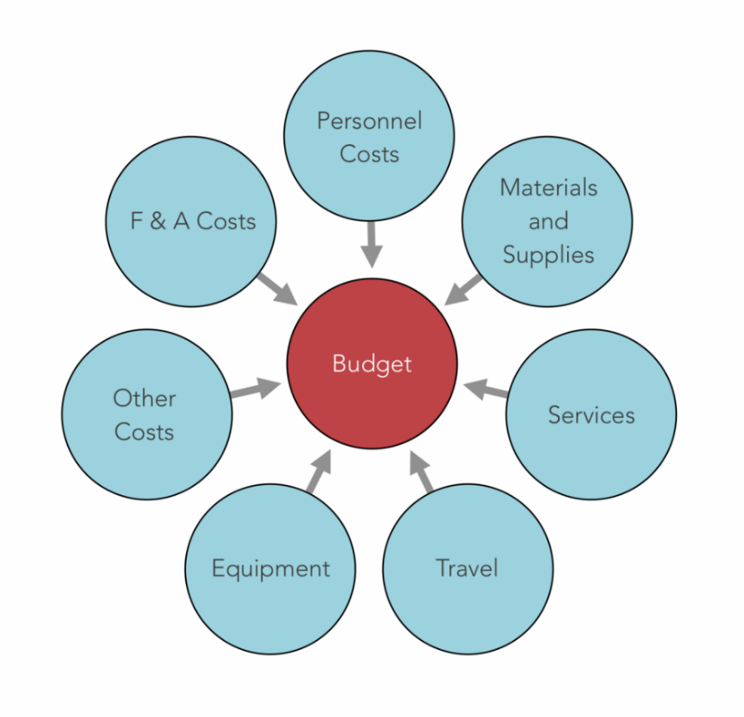
BUDGETS
We are here to help!!

Slide 20
Anatomy of a Budget
Direct Costs
Indirect Costs
Personnel
Equipment
Services
Subcontracts/sub-sites
Supplies & Materials directly related to the project
Travel
Publication costs
Other Expenses – Relevant, Related, Justified
Also called: IDC, F&A, Negotiated Costs, Administrative Costs
These costs are non-negotiable and are a cost of doing business. Rates vary based on the type of project, location of work, and sponsor allowability.

Slide 21
Personnel: people to do the work
  Principal Investigator
  Co-investigators, collaborators
  Consultants, mentors
  Research associates, specialists, technicians,
  Nurses, Clinical coordinators
  Post-docs
  Graduate students

Slide 22
Special Rule: NIH Salary Cap
Persons earning more than federal government Executive Level II, set each year
Currently: $192,300 @ 12.0 calendar months effort*
This is the base salary maximum that NIH will allow:
i.e. the salary cap
Cost share: The difference between the actual university base salary and this cap is covered by the university ‘sharing’ the cost of the research project

Slide 24
Budget Justification
All budgets require a written narrative explaining how the funds will be spent, known as the Budget Justification.
Describe Personnel and their roles & committed effort, types and costs of supplies, Travel (inc. mandatory by the sponsor), equipment, core and professional service fees, consortiums and subaward expenses (inc. their detailed budget).
Note: NIH modular budgets require Personnel, Consortium, and Additional Narrative (MTDC Exclusions, differing number of modules requested) justifications only
This commits the University and PI to spend funds in manner described. Some sponsors are more flexible than others allowing changes after an award is made, so be sure to become familiar with the policies governing each award. Our office can help you.

Slide 25
Where to find funding opportunities
UAHS Research Administration Website
http://research.uahs.arizona.edu/
UA Research Gateway
http://rgw.arizona.edu/
NIH Weekly Table Of Contents (TOC)
https://grants.nih.gov/grants/guide/listserv_dev.htm
Grants.gov: Manage Subscriptions (home page; top right) http://www.grants.gov/web/grants/manage-subscriptions.html
Community of Science (CoS) PIVOT
https://rgw.arizona.edu/development/funding-opportunities/search-databases-and-useful-funding-sources/cos-pivot

Slide 26
Funding Opportunity Announcement (FOA)
Investigator - Initiated
Parent R01 (Clinical Trial NOT Allowed): PA-19-056
Parent R01 (Clinical Trial Required): PA-19-055
Parent R21 (Clinical Trial NOT Allowed: PA-19-053
Parent R21 (Clinical Trial Required): PA-19-054
K Awards: K Kiosk (K for “C”areer)
RFA – Request for Funding Announcement
PA – Program Announcement – NIH topic interest
PAR – Program Announcement – special receipt dates
RFP – Request for Proposal – single receipt date

Slide 27
Career Development Awards
Can be Mentored or Independent, or a hybrid
Have very specific eligibility requirements
Generally require a significant commitment of protected research time: 50% to 75% of total effort
Generally support salary for PI up to a cap; no salary support for mentor/other faculty-level collaborators
Provide a small amount of funding to support project costs
Usually require an institutional commitment of support (additional funding, space, access to resources)
Last 2 to 5 years
Intended to lead to independent investigator-initiated funded research (R21, R01)

Slide 28
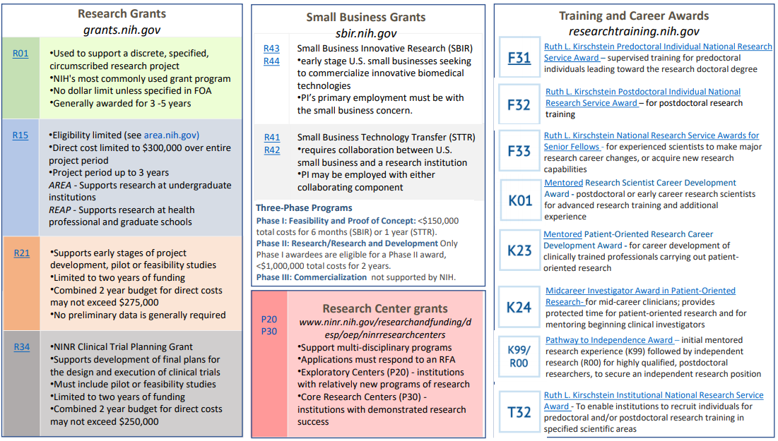
NIH NINR - Specific

Slide 29
Post-Submission
What happens next?
  Hurry up & wait – it will be months before you receive feedback
  Most awards start 6-9 months after a deadline date, or more
Peer review comments
If your proposal is in a fundable range:
  Additional information may be required
  Budget numbers are settled
  Submit protocols to IRB EARLY; missing approvals will delay your award. If you wait for the Just-in-Time request you will be LATE
Award documents are sent to Sponsored Projects
  You can begin spending on the project as of the start date

Slide 30
Grant Award
Grants are awarded to the applicant institution, not the individual PI
Not official until Notice of Grant Award (NOA) is received or contract/subcontract is fully executed
Read NOA carefully for restrictions; must be in compliance throughout the life of the grant. This includes reporting on Key Personnel, prior approval for effort changes, etc.

Slide 31
During the Award
Sponsored Projects
  Prepares financial reports / invoices
  Monitors account / deposits cash
  Assists PI and department with cost allowability questions*
  Assists PI and department with sponsor regulation questions*
The PI
  Oversees the proposed work
  Prepares technical/progress reports*
  Monitors expenditures
The PI’s department
  Works with SPCS on expenditure allowability
  Prepares requisition documents to make purchases
  Prepares interim cost reports for the PI

Slide 32
Award Management
Spending someone else’s money = high level of organization & responsibility
    Effort Tracking
    Expenditure Allowability
    Progress Reporting
    Compliance issues
    All while getting the research done (and searching for the next opportunity(ies)!)
Sponsored research is a coordinated effort
    Become familiar with the different offices
    Find out the rules of your department/college/institution/company (ITS Forms!)

Slide 33
UAHS Regulatory Services
Support UAHS Faculty with preparing, finalizing, and submitting completed applications and authorizations to both local and commercial IRBs
    New projects/deferrals, human research determinations, retrospective chart reviews;
    Modifications, consent form revisions;
    Partial HIPAA waivers;
    Continuing review;
    Safety/AE and protocol deviations
Assistance with the UAHS Research Intake Application (RIA) for Banner feasibility review and budget preparation
Assistance with processing regulatory start up documents (1572, financial disclosures, protocol signature page, site contact form, etc.), obtaining signatures and returning completed documents to Sponsor.
Protocol and Informed Consent development, support, review, and expertise for investigator-initiated studies.

Slide 34
UAHS Regulatory Services
Maintenance of electronic files and hard copy regulatory binders for assigned studies.
ClinicalTrials.gov submissions including closeout and posting of results for concluded studies.
Human Research training requirements and CITI dates
Just-In-Time Requests from Sponsors requiring proof of IRB approval
Study start-up support for Industry Sponsored protocols

Slide 35
Research Intake Application (RIA)
All submissions involving patients, facilities, services, health records, or resources of a clinical provider (e.g., Banner Health, Dignity Health) must be submitted via email (ResearchApp@email.arizona.edu) prior to submission to the University of Arizona Institutional Review Board (IRB).

Slide 36
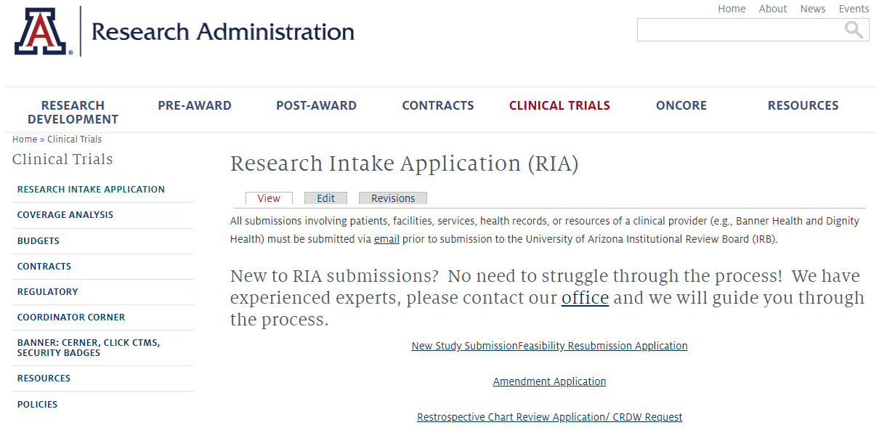
Research Intake Application (RIA) https://research.uahs.arizona.edu/clinical-trials/research-intake-form

Slide 37
UAHS Contracts
For any UAHS agreements not related to clinical trials including:
Confidentiality Disclosure Agreements (CDA)
Data Use Agreements (DUA)
Material Transfer Agreements (MTA)
Research Collaboration Agreements
Sub-federal Agreements
Education/Affiliation Agreements

Slide 38
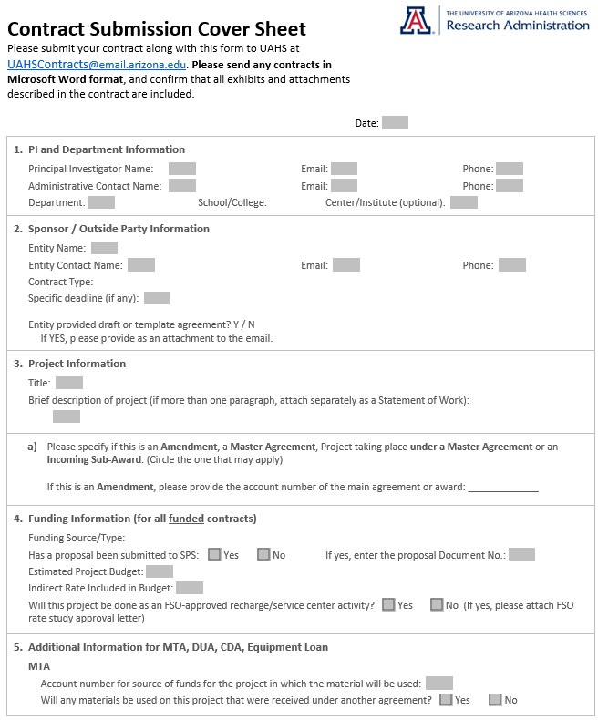
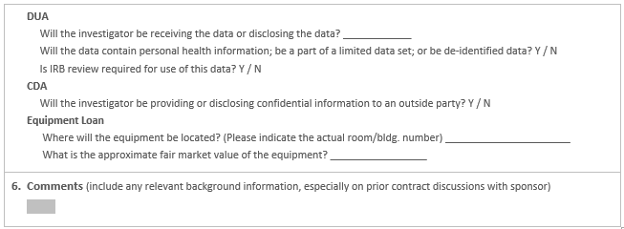
Contract Submission Cover Sheet
https://research.uahs.arizona.edu/content/contracts

Slide 39
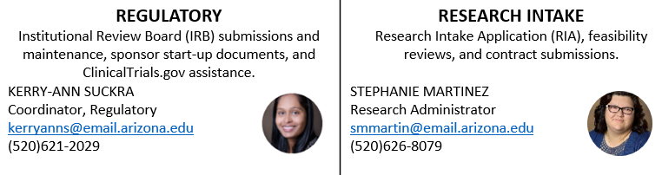
Navigation of the Process
We are here to guide PI’s and study teams through the Clinical Trial Process

Slide 40





Research Administration Services
Proposal Development
Find grant opportunities
Coordinate internal grant competitions
Maintain description of core facilities services
Develop and maintain trainee tracking database (T32s)
Grants
Budget development
Prepare grant administrative sections
Provide institutional support letters
Secure institutional Endorsements
Route for internal approvals
Submit grant to external sponsor
Progress reports
Sponsor prior approval & carryforward requests
Public Access Compliance
Consulting agreements, subawards
Grant close-outs &
no-cost extensions
Data reports and metrics
Departing PI transitions
Contracts
Receipt of award
Interpret terms and conditions as well as sponsor requirements
Offer consultations with faculty seeking external funding and explain university requirements relative to funding
Negotiate terms and conditions with sponsors
Sign the negotiated agreement
Regulatory
IRB application preparation and submission
Sponsor start-up documents
Protocol & informed consent development and review
Regulatory file maintenance
Clinicaltrials.gov
Research intake form (RIF) system navigation & guidance
Clinical Trials
Research Intake Form Management
Coverage Analysis development
Budget development, negotiation
Secure institutional endorsement for CTAs, CDAs, MTAs, amendments
Monthly Newsletter for Research Community
Visit earning reconciliation, invoicing
Cash collection, deposits

Slide 41

Website: http://research.uahs.arizona.edu/
Additional Contact Information:
For New Grants: Pre-Award
Preaward@email.arizona.edu
Grant pre-award questions including new submissions, searching for grant funding, advice on submission strategy, and letters of support
For Clinical Trials:
CRC@email.arizona.edu
Coverage analysis, budget development and negotiation support. Research Intake Form (RIF) questions.
For Existing Grants: Post-Award
Postaward@email.arizona.edu
Grant post-award questions including post-award management services (progress reporting and closeout), guidance on expenditure allowability, interpreting sponsor and institutional policies, and regulations.
For Clinical Trial Post-Award:
CTFinance@email.arizona.edu
Clinical Trial account reconciliation, sponsor payments, budget forecasting, and accounts payable functions.
For Research Intake Applications:
ResearchApp@email.arizona.edu
Research application submission for new projects, amended projects, and retrospective chart reviews.
For Contracting Support:
UAHSContracts@email.arizona.edu
UAHS Contracting questions and assistance including: clinical trials, material transfer agreements, confidentiality agreements, data use agreements, research collaborations, new student/resident service rotation contract requests, and more.
For Clinical Research Operations Support:
VPHS-CRO@email.arizona.edu
Clinical research questions, open clinical trial listings, study coordinator services, study preparation, and management questions.
For Regulatory Support:
Regulatory@email.arizona.edu
Regulatory submission assistance, Research Intake Form (RIF) navigation and questions, ClinicalTrials.gov, and general questions.

Slide 42
QUESTIONS?

