Slide 1
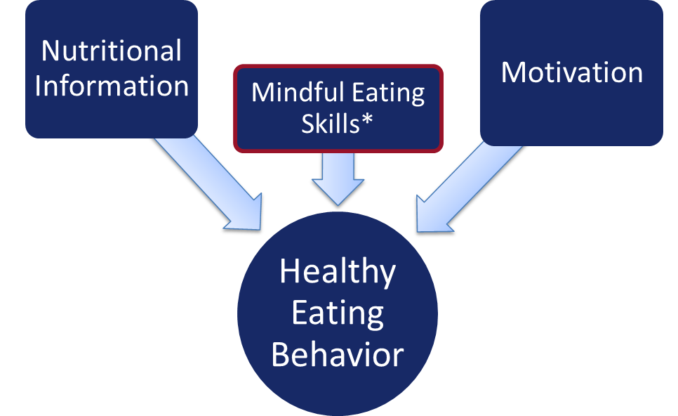
Bridging Academia and Business: Implementing a Mindful Eating Program in the Workplace
Patricia Daly, Ph.D., FNP-BC, ENP-BC, FAANP
Purpose
Theoretical Framework
Results
Translating research into practice to determine the feasibility and effectiveness of initiating a theory-guided mindful eating (ME) anti-obesity program in the workplace.
The Information Motivation Behavioral Skills Theory (IMB)
Measured Outcomes of City Worker Mindful Eating Program
VARIABLES | Pre-Intervention | Post-Intervention | Mean Improvement
Weight | 228±62.4 | 220±65.3 | 8
BMI | 38.4±11.4 | 37.3±11.5 | 1.1
HgBA1-C | 5.6±0.5 | 5.4±0.6 | 0.2
Systolic BP | 131±20.5 | 123±21.1 | 8
Diastolic BP | 86±10.8 | 84±12.5 | 2
Notes: All participants with exception of 1 outlier improved in all measures Notes: Weight recorded in pounds (lbs.) BMI = (Weight in pounds) / (Height in inches x Height in inches) x 73. Adapted from CDC, 2019.
Background
Reducing obesity is a priority for employers seeking to lower the incidence and severity of chronic illness and the associated demand for health care costs (HCC) and impact on productivity. _{(Yarborough III et al., 2018)}
ME anti-obesity programs have been shown to lower BMI and in contrast to western medicine anti-obesity interventions of pharmaceuticals and bariatric surgery. ME increases overall health while empowering the individual.(Daly, Pace, Berg, Menon, & Szalacha, 2016)
Information and motivation alone are often not adequate to change health behavior.(Fisher, Fisher, W. A., Williams, & Malloy, 1994)
Practicing a desired health behavior skill greatly enhances the adoption of a health behavior change. Fisher, Fisher, W. A., Williams, & Malloy, 1994)
This study evaluates a ME pilot program designed and implemented for city employees in Southern Arizona in 2015.
Methods
Fifteen city water workers (3M,12F, ages 36-60 yrs.) voluntarily participated in an in-person on-site ME program initiated at their workplace.
Weekly classes:
Information imparted nutrition including food preparation and fat and calorie content of food
Motivation enhanced with self-exploration of individual eating triggers and employing satiety sensitizing exercises
Behavioral skills acquired as participants practiced mindfully eating a catered buffet at each session
IRB consented participants’ HbA1c, blood pressure (BP) height and weight were recorded prior to and immediately following the program with a post-survey evaluating program effectiveness
Implications
Collaboration between academia and the workplace can result in dissemination of evidence-based research improving the health workers while.
Implementing a theory-guided ME intervention is both feasible and effective improving employee health with potential of lowering HCC while supporting translation of research into practice.
References

