Slide 1
Employing Therapeutic Yoga During Patient Encounters: An Effective Approach to Back Pain
Patricia Daly, Ph.D., FNP-BC, ENP-BC, FAANP

Slide 2
BACKGROUND
Systematic review found strong evidence for short-term effectiveness and moderate evidence for long-term effectiveness of yoga for chronic low back pain
<50% of compliance with prescribed physical therapy for back pain
Increase costs, delay in treatments and increase risk of chronic back pain
Bedrest patients experience more pain and slower recovery than ambulatory patients
Yoga is less costly, the use of breath reduces pain, empowers patient allowing them to explore their range of motion

Slide 3
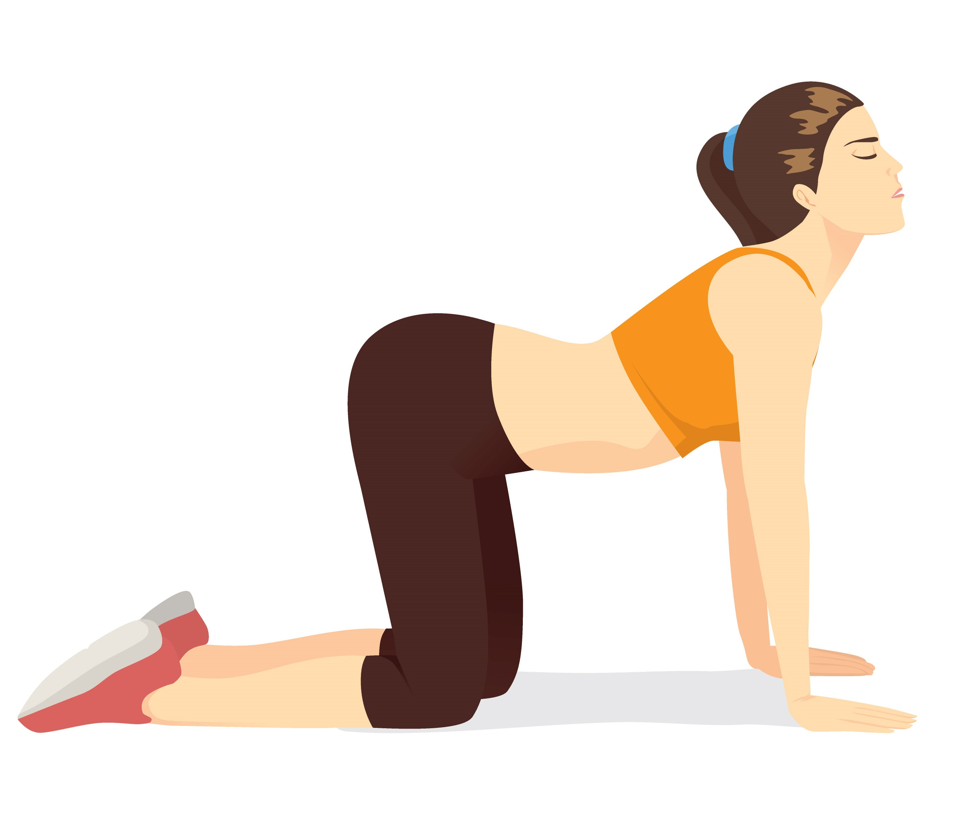
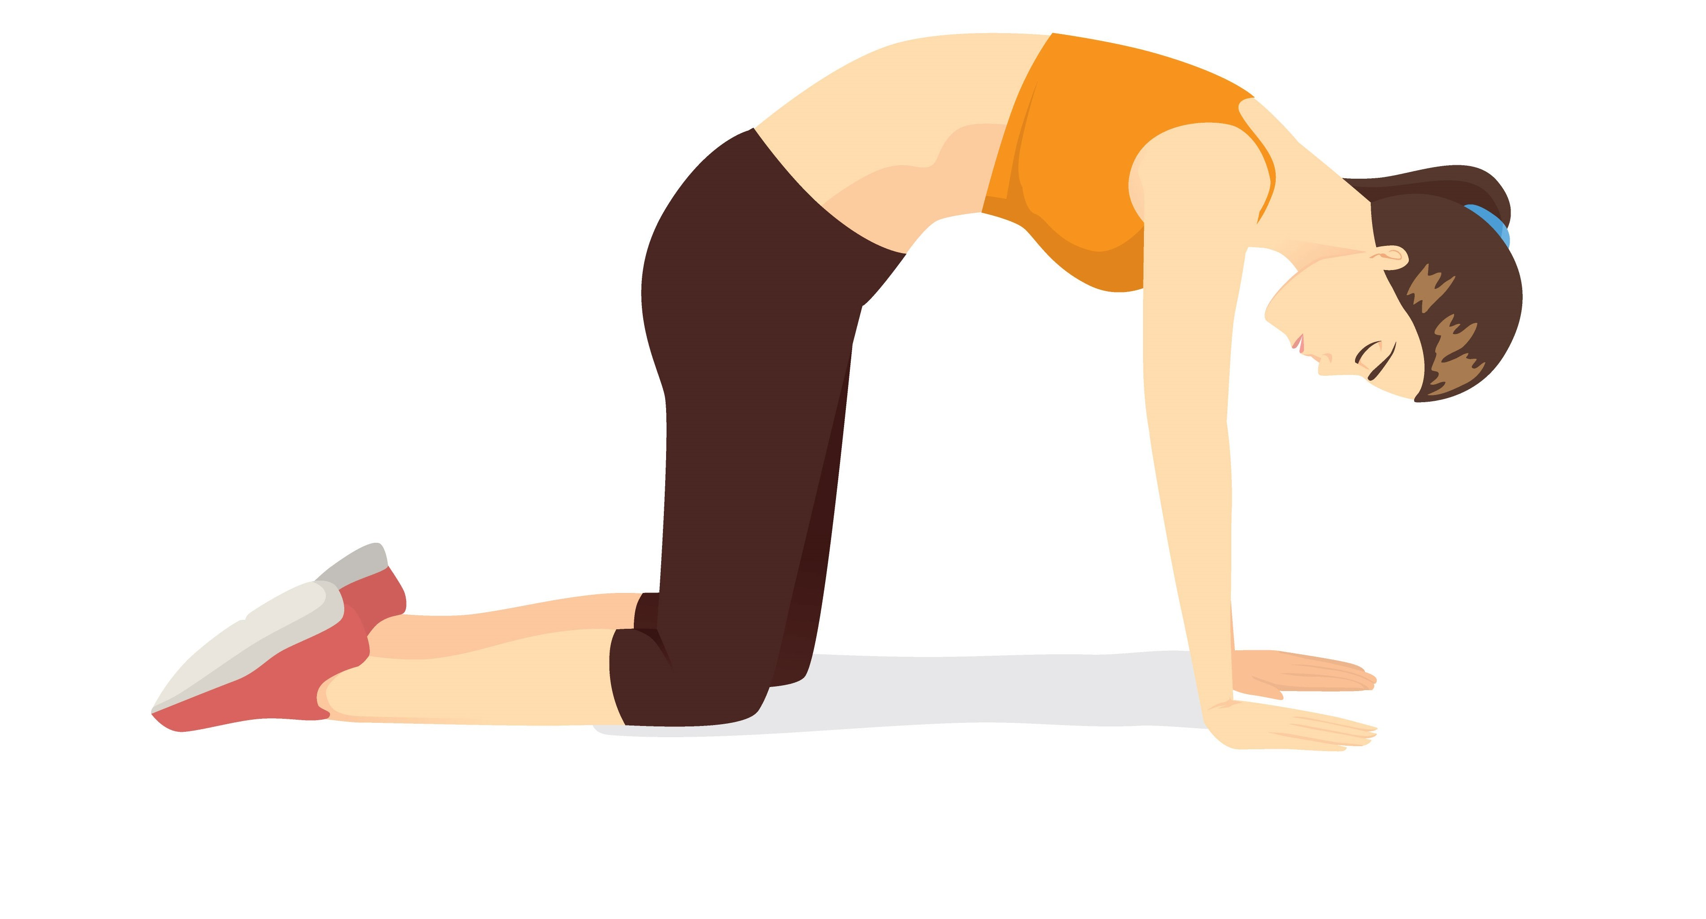
DID YOU KNOW?
The Cat-Cow Stretch has many health benefits. It is known to not only improve posture and flexibility, but also relive
back pain and sciatica
Initial Position
Cat Position

Slide 4
METHODS
EXAMINATION
Share rationale of large muscles impinging nerves causing pain
Position spine with knees flexed
Direct patient to inbreath and outbreath, slow breathing to oxygenate spasming muscles
Share rationale of palpation. Give immediate feedback on breath and position

Slide 5
METHODS
HOME THERAPY
Review of Cat-Cow Flow
Folded mat under knees
Fists positioned to support wrists
Consider Side Lying

Slide 6
IMPLICATIONS
Increased knowledge increases NP providers competence in utilization of appropriate patient centered evidence-based care
NPS will exemplify evidence-based practice empowering patients with non-pharmacological pain reducing interventions

